Slide 1
Multiple linear regression

Slide 2
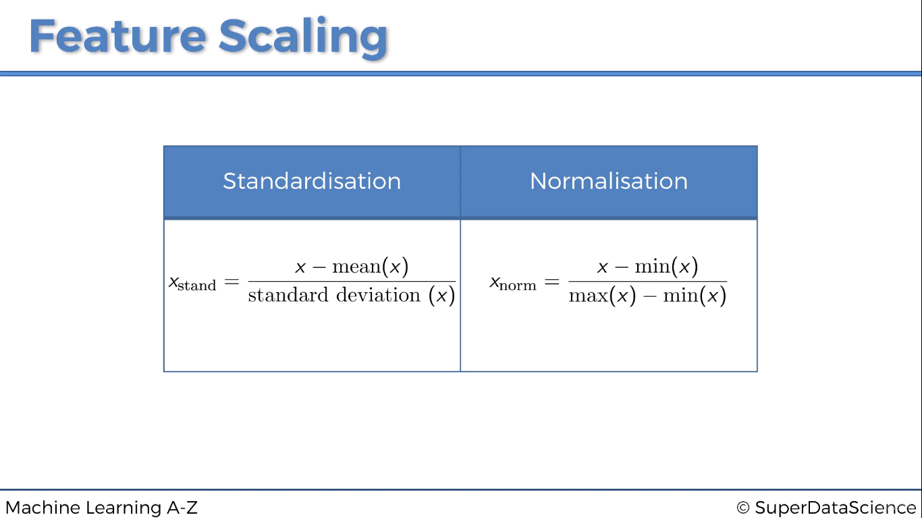

Slide 3
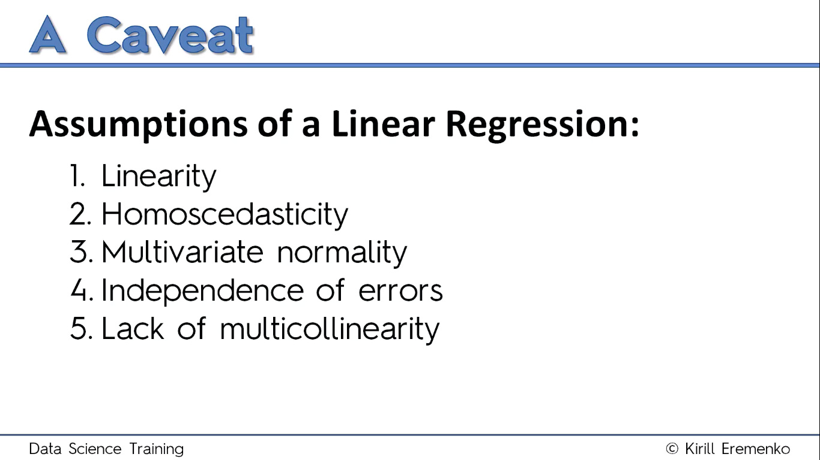

Slide 4
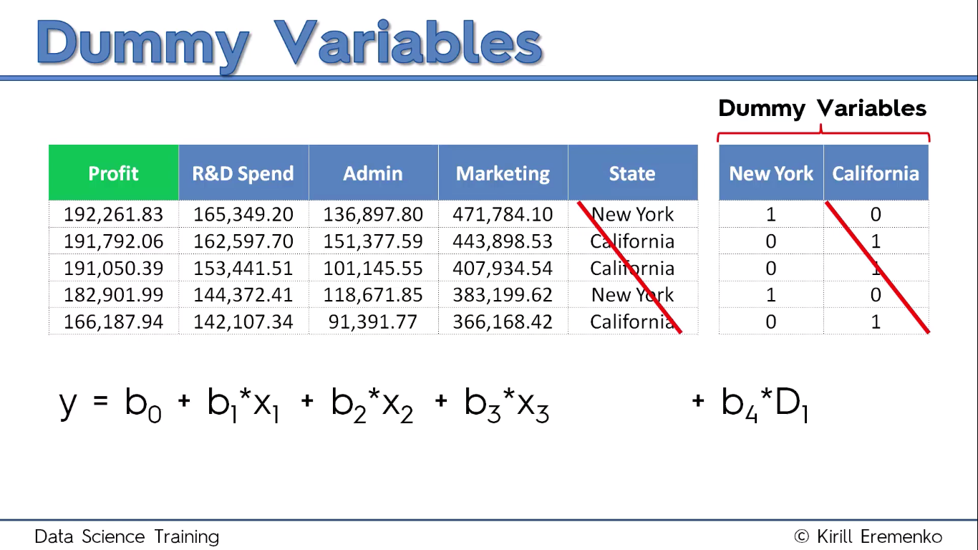

Slide 5
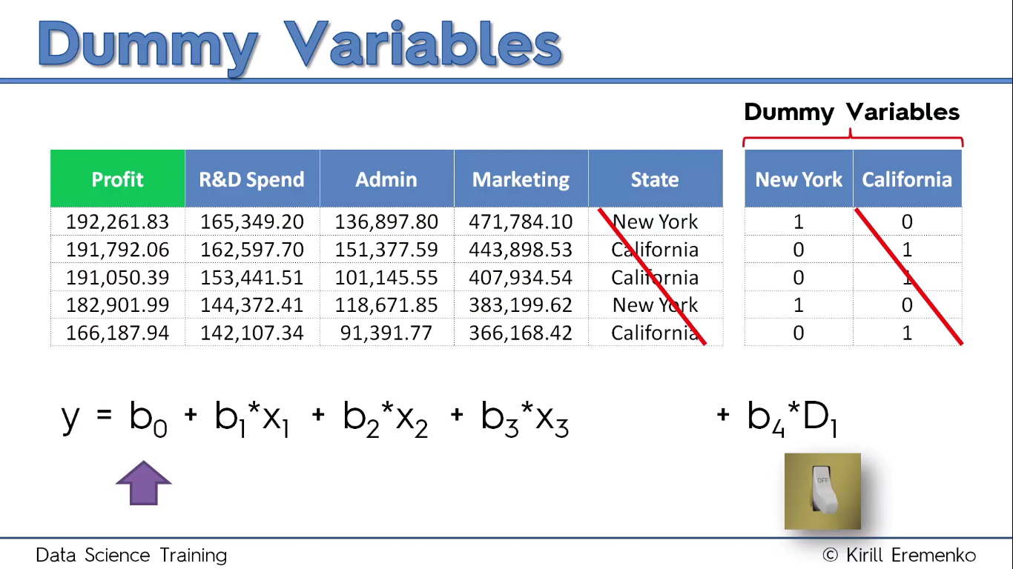

Slide 6
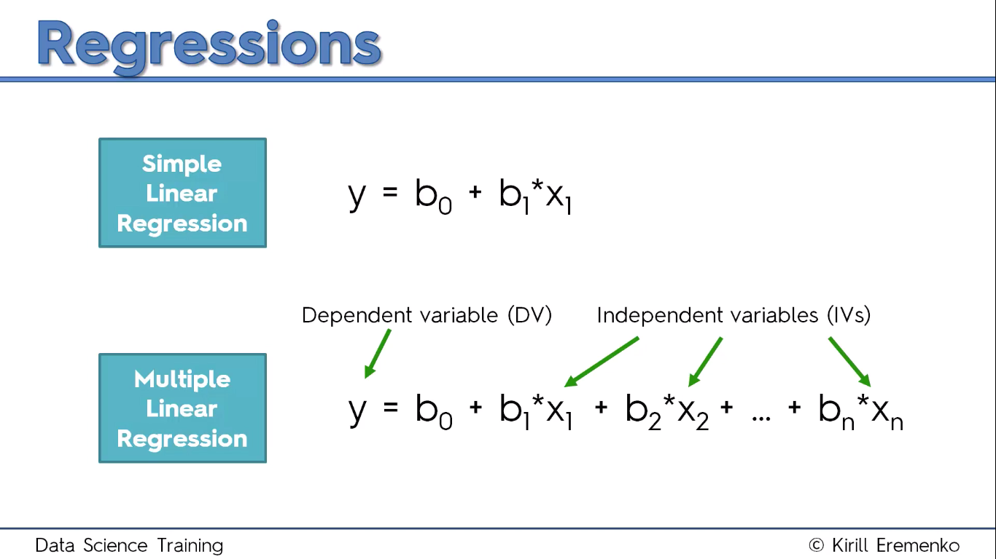

Slide 7
Python

Slide 8
# Importing the libraries
import numpy as np
import matplotlib.pyplot as plt
import pandas as pd

Slide 9
Importing datasets
dataset = pd.read_csv('50_Startups.csv')
X = dataset.iloc[:, :-1].values
y = dataset.iloc[:, 4].values

Slide 10
# Encoding categorical data
from sklearn.preprocessing import LabelEncoder, OneHotEncoder
labelencoder = LabelEncoder()
X[:, 3] = labelencoder.fit_transform(X[:, 3])
onehotencoder = OneHotEncoder(categorical_features = [3])
X = onehotencoder.fit_transform(X).toarray()

Slide 11
# Avoiding the Dummy Variable Trap
X = X[:, 1:]
NOTE : if you have n dummy variables remove one dummy variable to avoid the dummy variable trap. However the linear regression model that is built in R and Python takes care of this. But there is no harm in removing it by ourselves.

Slide 12
Splitting the dataset into the Training set and Test set
from sklearn.cross_validation import train_test_split
X_train, X_test, y_train, y_test = train_test_split(X, y, test_size = 0.2, random_state = 0)

Slide 13
Fitting Multiple Linear Regression to the Training set
from sklearn.linear_model import LinearRegression
regressor = LinearRegression()
regressor.fit(X_train, y_train)

Slide 14
Predicting the Test set results
y_pred = regressor.predict(X_test)

Slide 15
Model performance
from sklearn.linear_model import LinearRegression
regressor = LinearRegression()
model = regressor.fit(X_train, y_train)
model.score(X_test, y_test)

Slide 16
Building the optimal model using Backward Eliminatio
import statsmodels.formula.api as sm
X = np.append(arr = np.ones((50, 1)).astype(int), values = X, axis = 1)
X_opt = X[:, [0, 1, 2, 3, 4, 5]]
regressor_OLS = sm.OLS(endog = y, exog = X_opt).fit()
regressor_OLS.summary()

Slide 17
X_opt = X[:, [0, 1, 3, 4, 5]]
regressor_OLS = sm.OLS(endog = y, exog = X_opt).fit()
regressor_OLS.summary()
X_opt = X[:, [0, 3, 4, 5]]
regressor_OLS = sm.OLS(endog = y, exog = X_opt).fit()
regressor_OLS.summary()
X_opt = X[:, [0, 3, 5]]
regressor_OLS = sm.OLS(endog = y, exog = X_opt).fit()
regressor_OLS.summary()
X_opt = X[:, [0, 3]]
regressor_OLS = sm.OLS(endog = y, exog = X_opt).fit()
regressor_OLS.summary()

Slide 18
R

Slide 19
Importing the dataset
dataset = read.csv('50_Startups.csv')

Slide 20
Encoding categorical data
dataset$State = factor(dataset$State,
levels = c('New York', 'California', 'Florida'),
labels = c(1, 2, 3))

Slide 21
Splitting the dataset into the Training set and Test set
library(caTools)
set.seed(123)
split = sample.split(dataset$Profit, SplitRatio = 0.8)
training_set = subset(dataset, split == TRUE)
test_set = subset(dataset, split == FALSE)

Slide 22
Fitting Multiple Linear Regression to the Training set
regressor = lm(formula = Profit ~ ., data = training_set)

Slide 23
Predicting the Test set results
y_pred = predict(regressor, newdata = test_set)

Slide 24
Building the optimal model using Backward Elimination
regressor = lm(formula = Profit ~ R.D.Spend + Administration + Marketing.Spend + State, data = dataset)
summary(regressor)

Slide 25
regressor = lm(formula = Profit ~ R.D.Spend + Administration + Marketing.Spend, data = dataset)
summary(regressor)
regressor = lm(formula = Profit ~ R.D.Spend + Marketing.Spend, data = dataset)
summary(regressor)
regressor = lm(formula = Profit ~ R.D.Spend, data = dataset)
summary(regressor)

